Slide 1

NITTE MEENAKSHI INSTITUTE OF TECHNOLOGY (AN AUTONOMOUS INSTITUTION, AFFILIATED TO VISVESVARAYA TECHNOLOGICAL UNIVERSITY, BELGAUM, APPROVED BY AICTE & GOVT.OF KARNATAKA)
A NEW APPROACH TO DETECT CYCLE IN A DIRECTED GRAPH
USING LINKED LIST
Faculty In-charge : Dr. Chaitra Naveen
Submitted By:
Bibek Yadav : 1NT19CS055
Chiraag Jung Thapa : 1NT19CS060
M Venkatesh : 1NT19CS115
LA-2 SEMINAR PRESENTATION

Slide 2
TABLE OF CONTENTS
Introduction About AINN
Introduction About Cyclic Detect
What Is Cyclic Detection ?
Applications Of Cycle
Simplification Of Algorithm
Drawbacks
Future Scope
Conclusion
Reference

Slide 3
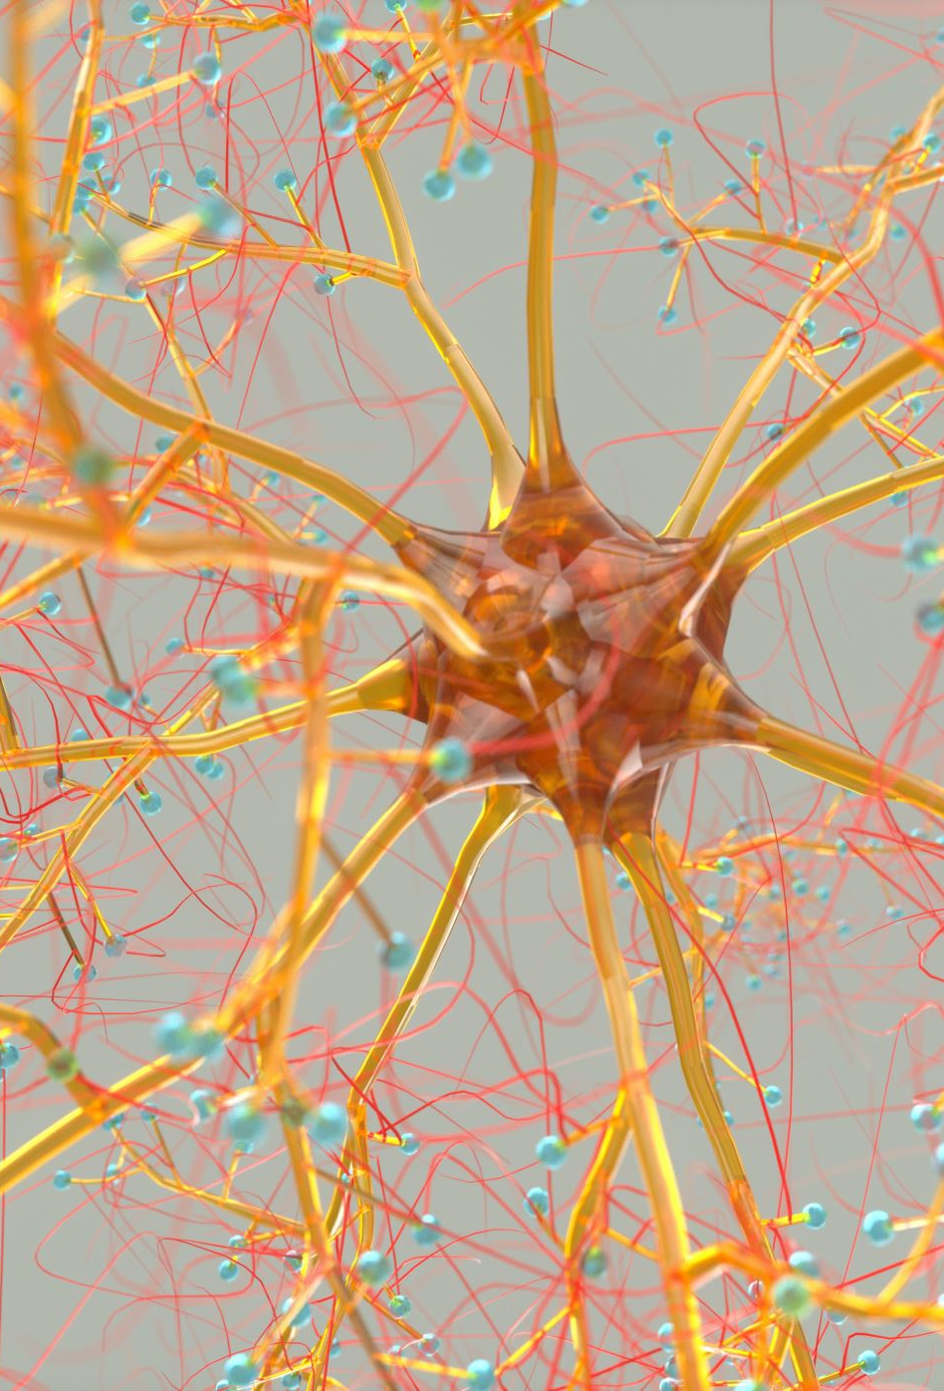
Introduction About AINN
Artificial Neural Networks (ANN) are algorithms based on brain function and are used to model complicated patterns and forecast issues.
The Artificial Neural Network (ANN) is a deep learning method that arose from the concept of the human brain Biological Neural Networks.
ANNs are composed of multiple nodes, which imitate biological neurons of human brain. The neurons are connected by links and they interact with each other.
The output at each node is called its activation or node value. Each link is associated with weight.
ANNs are capable of learning, which takes place by altering weight values.

Slide 4
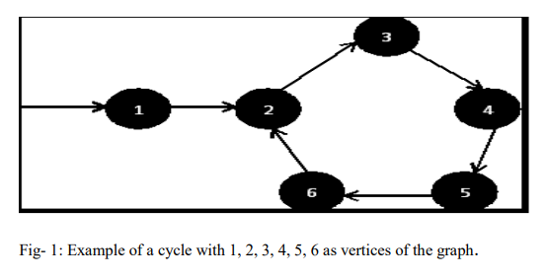
Introduction : Cyclic Detect
Cycle: A cycle is repeating part in the sequence.
In computer science, cycle detection is the algorithmic problem of finding a cycle in a sequence of iterated function values . Suppose in a function f(x), if x repeats the same sequence of values once again, then there exist a cycle.
To detect cycle, check for a cycle in individual trees by checking back edges.
In graph theory, a cycle in a graph is a non-empty trail in which only the first and last vertices are equal.

Slide 5
What Is Cyclic Detection ?
we have developed a new technique to detect the number of cycles in a directed graph and showed the entire traversed node that forms cycle by displaying it at the time of using counter that incremented at the time of detecting cycle.
In addition, when the cycle detects, the same time traversed list is deleted hence, that saved the space. Insertion of nodes from directed graph inserts in the singly linked list. The procedure of this algorithm is much easier to implement and execute for digraph and directed multigraph.
This algorithm can be beneficial in detecting infinite loops in certain computer program. The proposed algorithm expected to be of great interest in theory and practice alike

Slide 6
Applications Of Cycle
Cycle detection may be helpful as a way of discovering infinite loops in certain types of computer programs .
Use of wait-for graphs to detect deadlocks in concurrent system .
Periodic configurations in cellular automaton simulations may be found by applying cycle detection algorithms to the sequence of automaton states .
In cryptographic applications, the ability to find two distinct values xμ−-1 and xλ+μ−-1 mapped by some cryptographic function ƒ to the same value xμ may indicate a weakness in ƒ.
For instance, Quisquater and Delescaille apply cycle detection algorithms in the search for a message and a pair of Data Encryption Standard keys that map that message to the same encrypted value; Kaliski, Rivest, and Sherman also use cycle detection algorithms to attack DES. The technique may also use to find a collision in a cryptographic hash function.
Analysis of electrical networks, periodic scheduling, analysis of chemical and biological pathways

Slide 7
Simplification Of Algorithm
Take the number of edges and vertices as user input.
Initialize the current index, visited, and recursion stack using recursion
Mark the index in the recursion stack and the current node as visited.
Make recursive calls for all the unvisited adjacent vertices for the current node, and if any of these recursive functions return true, return true as the final answer
If any adjacent vertices are already visited in the recursion stack, mark the answer as true.
Return false if none of the above steps returns true

Slide 8
Drawbacks
The algorithm compares with each subsequent sequence value up to the next power of two, stopping when it finds a match.
It finds the correct length of the cycle directly, rather than needing to search for it in a subsequent stage, and its steps involve only one evaluation of rather than three.
We only additionally store two nodes of the linked list to determine where the fast or slow pointer
The equality test action may involve some nontrivial computation

Slide 9
Future Scope
The above-proposed algorithm helps in detecting cycle in any digraph takes much space to execute and its complexity is much higher in case of worst case.
Therefore, using this method and logic, in future new logics may define to overcome the complexity and space problems.
This algorithm can be used in detecting infinite loops in various computer programs, analysis of electrical networks, periodic scheduling and in many more places where there is a need to detect cycle.

Slide 10
Conclusion
In this paper, we have developed a new technique to detect the number of cycles in a directed graph and showed the entire traversed node that forms cycle by displaying it at the time of using counter that incremented at the time of detecting cycle.
In addition, when the cycle detects, the same time traversed list is deleted hence, that saved the space.
Insertion of nodes from directed graph inserts in the singly linked list.
The procedure of this algorithm is much easier to implement and execute for digraph and directed multigraph.
This algorithm can be beneficial in detecting infinite loops in certain computer program.
The proposed algorithm expected to be of great interest in theory and practice alike.

Slide 11
References
Piotr Puczynski,” The cycle detection algorithms”, Wroclaw University of Technology, Faculty of Management
Van Gelder, Allen (1987), "Efficient loop detection in Prolog using the tortoise-and-hare technique", Journal of Logic Programming 4 (1): 23– 31, doi: 10.1016/0743-1066(87)90020-3
Silberschatz, Abraham; Peter Galvin, Greg Gagne (2003). Operating System Concepts. John Wiley & Sons, INC. p. 260. ISBN 0-471-25060-0
Nivasch, Gabriel (2004), "Cycle detection using a stack", Information Processing Letters 90 (3): 135–140, doi: 10.1016/j.ipl.2004.01.016
Quisquater, J.-J.; Delescaille, J.-P., "How easy is collision search? Application to DES", Advances in Cryptology – EUROCRYPT '89, Workshop on the Theory and Application of Cryptographic Techniques, Lecture Notes in Computer Science 434, Springer-Verlag, pp. 429–434
Kaliski, Burton S., Jr.; Rivest, Ronald; Sherman, Alan T. (1988), "Is the Data Encryption Standard a group? (Results of cycling experiments on DES)", Journal of Cryptology 1 (1): 3–36, doi: 10.1007/BF00206323
H.D. Rozenfeld et al. Statistics of cycles: how loopy is your network? J.Phys. A: Math.Gen. 38:4589, 2005.
M. Medard and S. S. Lumetta. Network reliability and fault tolerance. In J. Proakis, editor, Wiley Encyclopaedia of Engineering.

Slide 12


